Slide 1
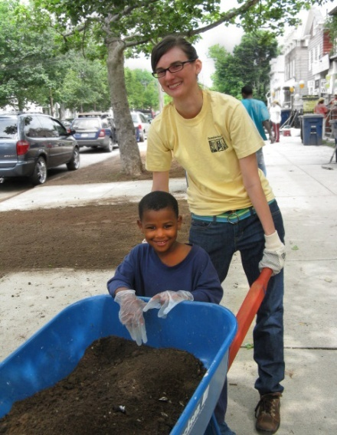
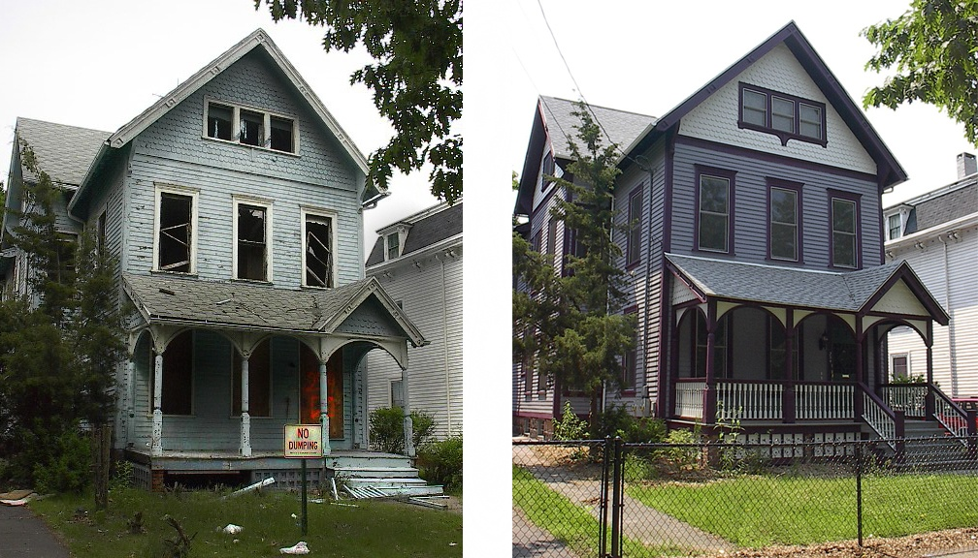
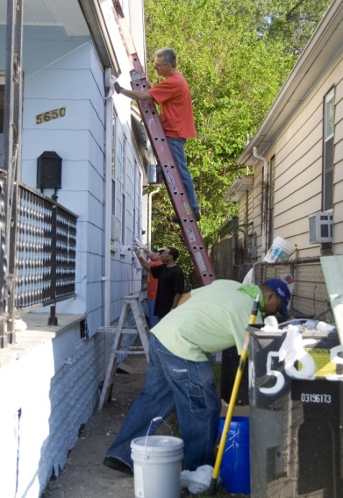
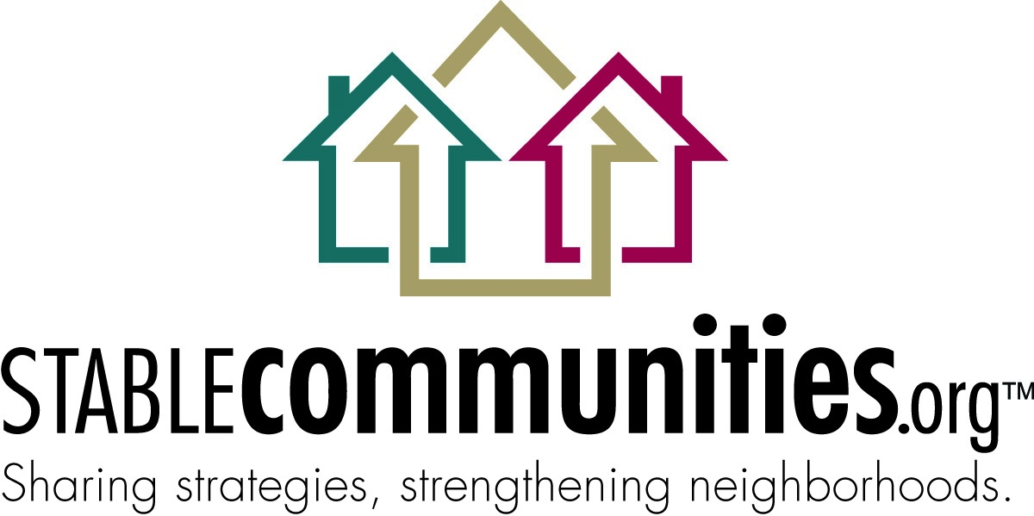
Community Stabilization Initiative
NeighborWorks America VISTA Webinar
November 15, 2010
Working Together for Stronger Communities

Slide 2
Community Stabilization Staff
Sarah Greenberg, Senior Manager
Ascala Sisk, Management Consultant
Allison McMullin, Program Assistant
Division of National Initiatives and Applied Research (NIAR) at NeighborWorks America in DC
Working Together for Stronger Communities

Slide 3
Impacts of the Foreclosure Crisis
CRL predicts 12 million more foreclosures, 1 in 4 homes underwater
Foreclosed homes become vacant or abandoned
Attracts vandalism and crime
Reduces neighboring property values
Lowers property tax revenues = reduces local government services
Attracts speculators looking for easy profit
People who can move out, local businesses lose customers, commercial corridors deteriorate
Working Together for Stronger Communities

Slide 4
What is Community Stabilization?
Community stabilization is a set of interventions designed to stop the downward spiral and restore a healthy market dynamic
Effective interventions address all destabilizing forces in a community
Real estate and non-real estate interventions
Working Together for Stronger Communities

Slide 5
Network’s Role in Community Stabilization
Annual Survey Data as of 01/2010, # NW organizations:
Acquired foreclosed properties for rental or resale: 159
Cleanup or crime watch program to address vacant property issues: 128
Counseled buyers to purchase foreclosed properties: 192
Lending for purchase of foreclosed properties: 84
Purchased delinquent mortgage loan notes: 15
Real estate brokerage services to sell foreclosed properties: 11
Working Together for Stronger Communities

Slide 6
Neighborhood Stabilization Program, Round 1
Housing and Economic Recovery Act 2008, Congress created the Neighborhood Stabilization Program (NSP)
First round = $3.92 billion
Administered by HUD
Need-based formula allocation
309 state and local government grantees, minimum $19.6 million per state
Working Together for Stronger Communities
Notes:
Formula allocation considered the number and percentages of subprime loans and foreclosures to determine funding allocations

Slide 7
Neighborhood Stabilization Program, Round 1, cont.
18 months to obligate funds
5 eligible uses – financing mechanisms, purchase/rehab, demolition, land banking, redevelopment
Homebuyers assisted must receive counseling
Anticipated to impact 100,000 properties
Many communities did not have the capacity to effectively use the funds
110 Network organizations working with Round 1 funds
Working Together for Stronger Communities
Notes:
99% of funds were obligated as of 18 month deadline
NSP1 is not over – now is when the work really begins to rehab and rent or sell the properties
Much of the funds will be recaptured as program income and recycled into additional NSP-eligible projects

Slide 8
Neighborhood Stabilization Program, Round 2
American Recovery and Reinvestment Act 2009
$2 billion ($20 million for technical assistance)
Competitive application, open to nonprofits and consortia
56 grantees
3 years to expend funds
19 Network organizations received allocations of Round 2 funds
Combined NSP2 allocation of $204 million, which places NeighborWorks at the top of all networks receiving NSP2 funds
Working Together for Stronger Communities
Notes:
Designed to get the funds in the hands of groups with the capacity to use them effectively
Some places that needed funds did not get them due to competitive process
Grantees not all set up to administer government funds

Slide 9
Neighborhood Stabilization Program, Round 3
Dodd-Frank Wall Street Reform and Consumer Protection Act of 2010
$1 billion ($970 million allocated, $20 million for technical assistance, $10 million for HUD administration)
Formula allocation
280 grantees (228 city/county grantees); 60 new NSP grantees
Minimum $5 million to each state (top 5 states: FL, CA, MI, OH, GA)
Grantee Action Plans due to HUD by March
Working Together for Stronger Communities

Slide 10
National Community Stabilization Trust
Late 2007, NeighborWorks began working with partners to help communities struggling with the impacts of foreclosure
Identified 2 major issues:
Difficulty finding out who owned and controlled foreclosed properties
Competition with speculators
Working Together for Stronger Communities

Slide 11
National Community Stabilization Trust
NeighborWorks and its partners created NCST to address these issues
Provides listings of all foreclosed properties available for sale from participating lenders
Allows 12-14 days for participating non-profits and local governments to purchase properties before they are listed for sale and available to other buyers, including speculators (First Look)
Provides additional funding for local efforts
Working Together for Stronger Communities

Slide 12
National Community Stabilization Trust
Operating in 150 communities
Transferred close to 3,000 properties
Working with all the major lenders that own foreclosed properties
In 2010, HUD endorsed the program and offered it to all NSP grantees, and encouraged more lenders to participate
Working Together for Stronger Communities

Slide 13
5 Cs of Community Stabilization
What makes an effective community stabilization effort?
Comprehensive – community stabilization efforts should result from a plan that addresses all destabilizing forces in the community
Concentration – community stabilization efforts should be targeted for maximum impact
Collaboration – community stabilization efforts should include a broad array of partners with a strong focus on resident engagement
Capacity – community stabilization efforts should be undertaken by organizations with demonstrated capacity in the planned activities
Capital – community stabilization efforts should be adequately capitalized and explore creative methods to take advantage of new sources of capital
Working Together for Stronger Communities

Slide 14
The Future of Community Stabilization
A trend towards comprehensive, place-based strategies in community development
White House Neighborhood Revitalization Initiative provides new funding to rebuild communities
Choice Neighborhoods
Promise Neighborhoods
Byrne Criminal Justice Innovation
Community Health Centers and Behavioral Health Services
New interagency coordination around livable communities
Working Together for Stronger Communities

Slide 15
FY10 Program Results
Re-launched www.StableCommunities.org with all new content
22,530 people visited the website 31,492 times in FY10
Convened more than 1,000 practitioners at 14 in-person events and 12 online webinars
Provided $3.14 million in expendable grant funds
Managed $215,000 direct technical assistance to NSP2 grantees
Created Responsible Redevelopment case study series (10 organizations)
Produced 3 videos on community stabilization efforts
48 NWOs working with the NCST to acquire foreclosed properties
$10.6 million in NCST REO Capital Fund loans approved (5 organizations)
Network returned over 2,500 single-family REOs to productive use
Working Together for Stronger Communities
Notes:
REO returned to productive use - data in 2010 is limited to single-family homes, FY11 data will also track multifamily rental properties
Grants - Round 1 operating support, PolicyMap, Housing Developer Pro, NSP2, Community Central

Slide 16
FY11 Program Goals
Goal #1: Lead the industry in advancing community stabilization efforts.
Maintain and grow www.StableCommunities.org as a go to resource for non-profits working in stabilization/revitalization
Develop and deliver high-quality training on community stabilization/revitalization topics (webinars, workshops, regional/national convenings, training curriculum)
Promote the community stabilization/revitalization leadership of NeighborWorks America and the NeighborWorks Network
Working Together for Stronger Communities

Slide 17
FY11 Program Goals
Goal #2: Support the leadership of NWOs in community stabilization on the local level.
Provide funding to support local community stabilization/revitalization efforts
Provide timely technical assistance to build nonprofit capacity in community stabilization/revitalization
Strengthen national partnerships to facilitate local efforts
Monitor risk of NWOs administering NSP
Working Together for Stronger Communities

Slide 18
FY11 Program Goals
Goal #3: Establish comprehensive community revitalization as a strategic programmatic focus for NeighborWorks America and the NeighborWorks Network.
Community Revitalization Pilot
Maximize effectiveness/influence of Community Stabilization Committee
Create, disseminate, and promote best practices that promote the 5 Cs of Community Stabilization
Working Together for Stronger Communities

Slide 19
Thank You
Visit www.StableCommunities.org for information and resources to stabilize communities in the wake of the foreclosure crisis.
Working Together for Stronger Communities

