Slide 1
Green Building!
Kyle Rogers
James Ruhland
Community Design Studio, LLC.

Slide 2
What is Green Building?
With so many ways to define green development strategies how can you trust in any one claim over another? Furthermore, how can I know that I’m working on a green project?
For now, working definitions fall into three main categories:
Efficient Systems.
Low Impact Development.
Remedial Structures.

Slide 3
Can it be measured?
Every building component/system has direct and indirect effects. These collective effects constitute a massive data stream … that data can conclusively demonstrate the effects of green buildings.
Data can validate the claims set forth by green buildings.
Sometimes the data mechanism is a utility bill, other times it can be measuring social behavior.
The underlying premise of any scoring system is the ability to measure results by the scientific method.
The work for every Green Project has five major facets …

Slide 4
Facets
Sustainable Sites
Water Efficiency
Energy & Atmosphere
Materials & Resources
Indoor Environmental Quality
Design Innovation

Slide 5
Sustainable Sites

Slide 6
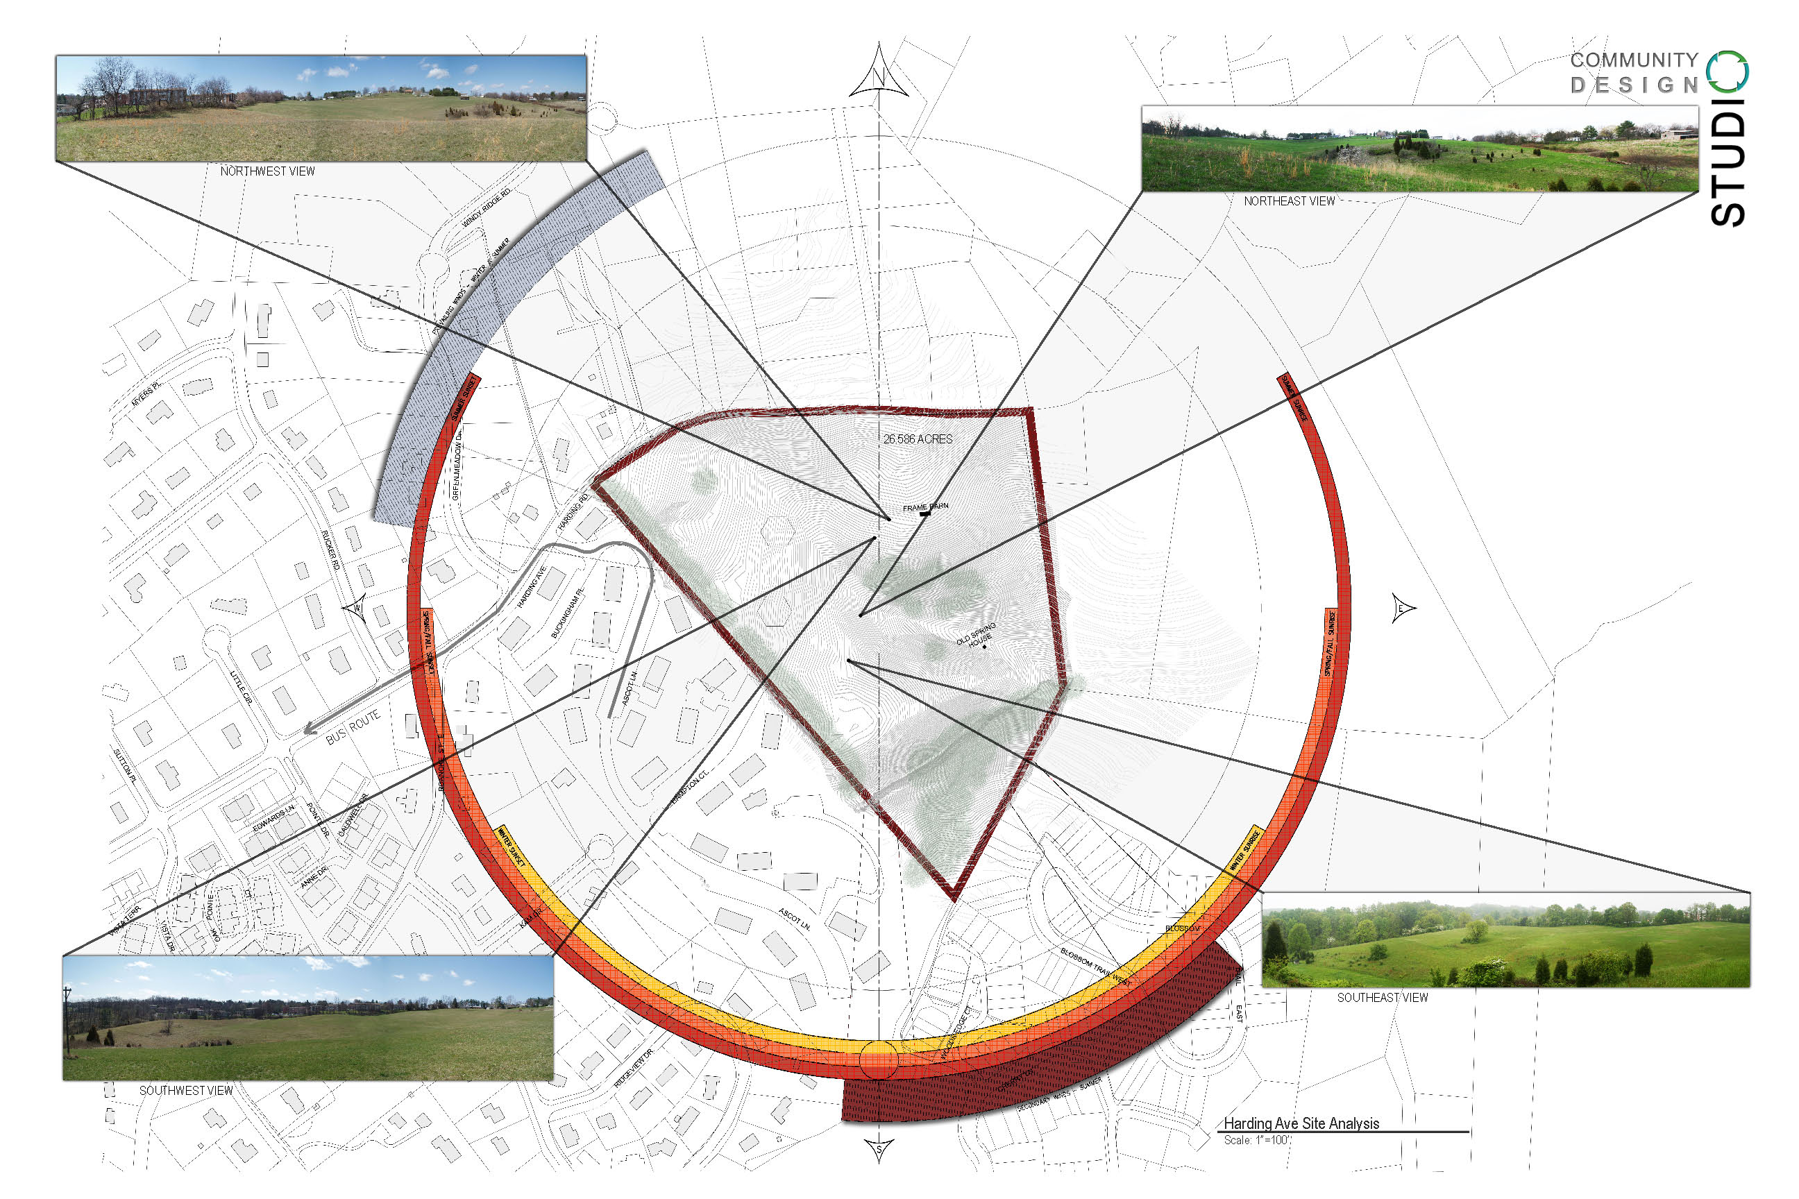

Slide 7
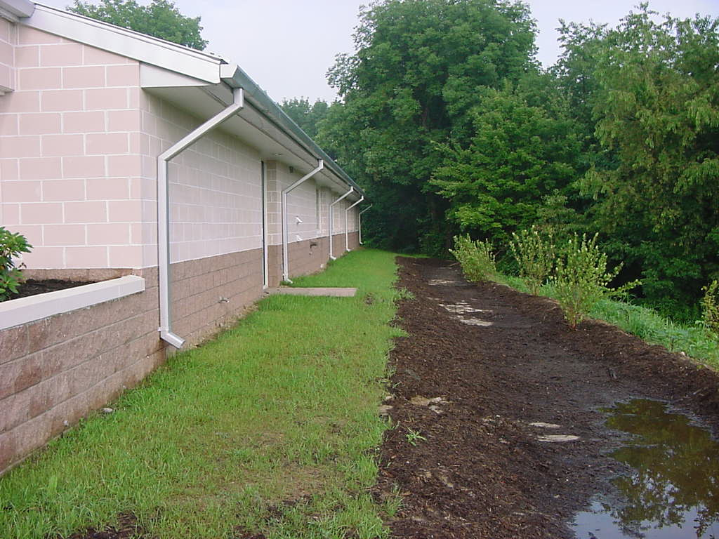

Slide 8
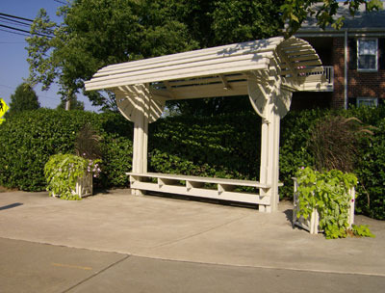

Slide 9
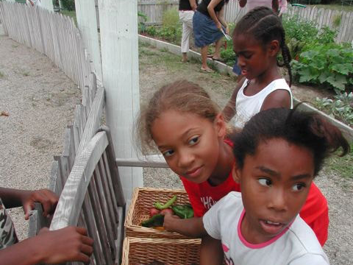

Slide 10
Water Efficiency

Slide 11
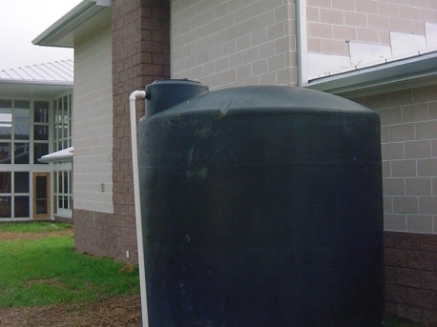

Slide 13
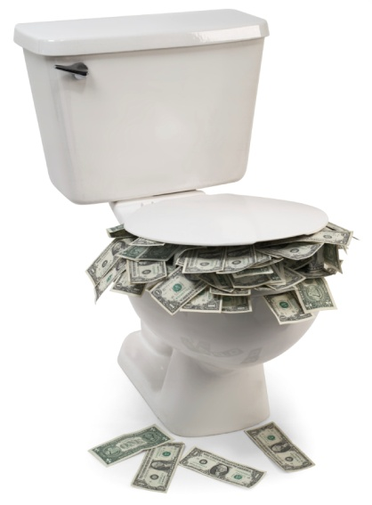
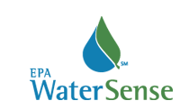

Slide 14
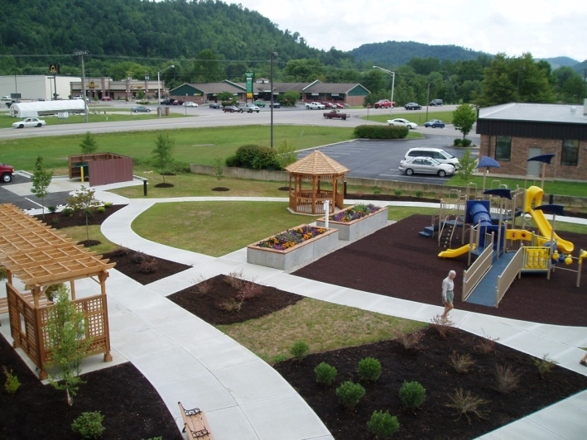

Slide 15
Energy & Atmosphere

Slide 16
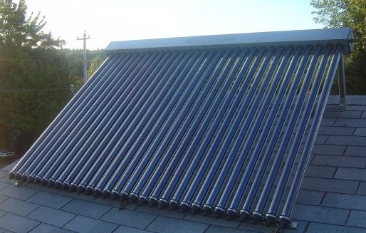

Slide 17
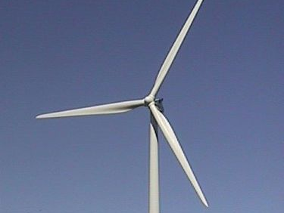

Slide 18
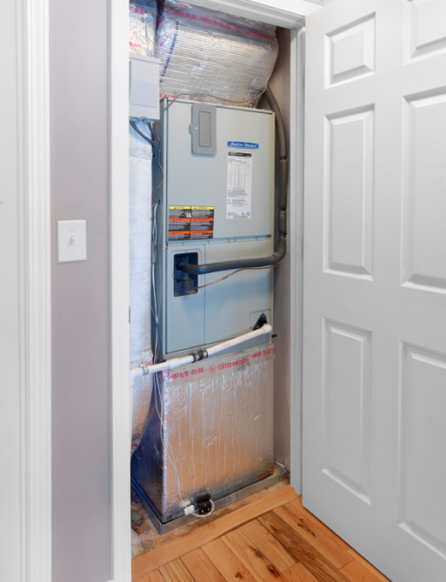

Slide 19
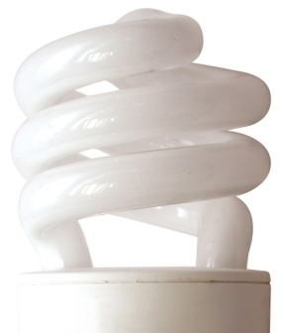
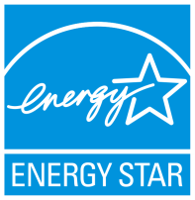

Slide 21
Materials & Resources

Slide 22
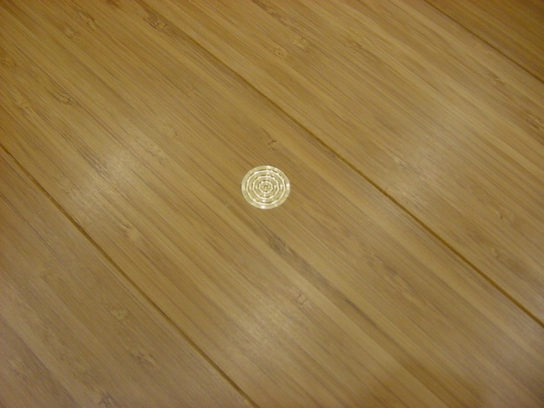

Slide 23
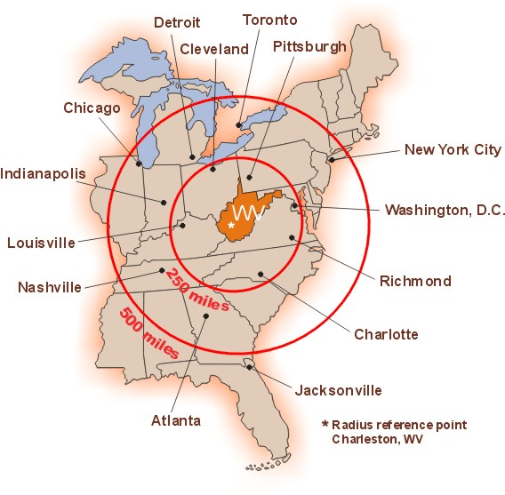

Slide 24
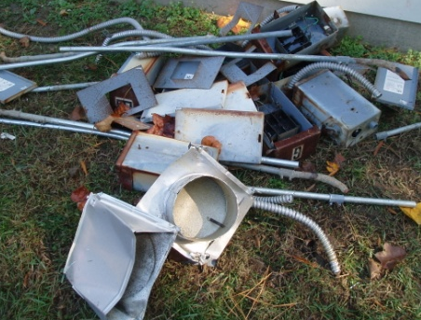
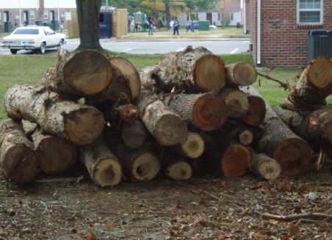
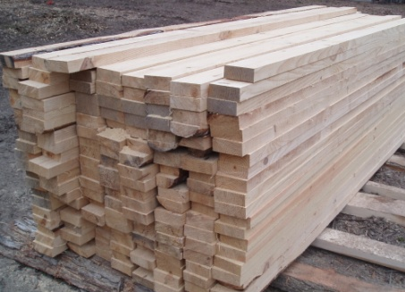

Slide 25
The Breakdown
Indoor Environmental Quality

Slide 26
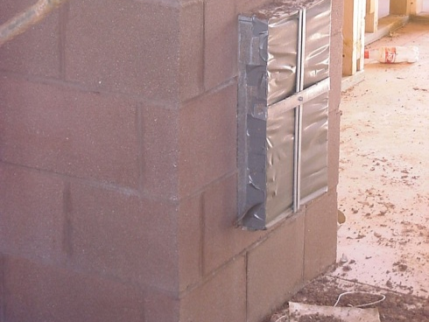

Slide 28
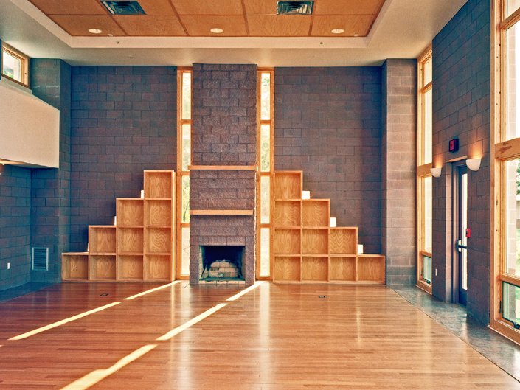

Slide 29
The Breakdown
Design Innovation

Slide 30
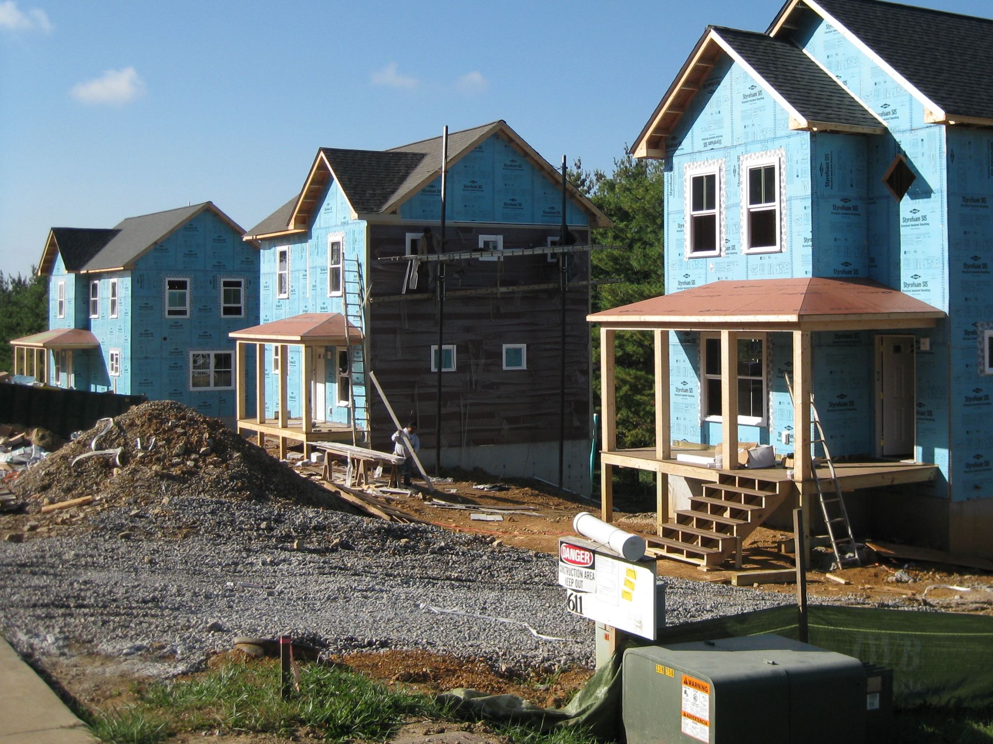
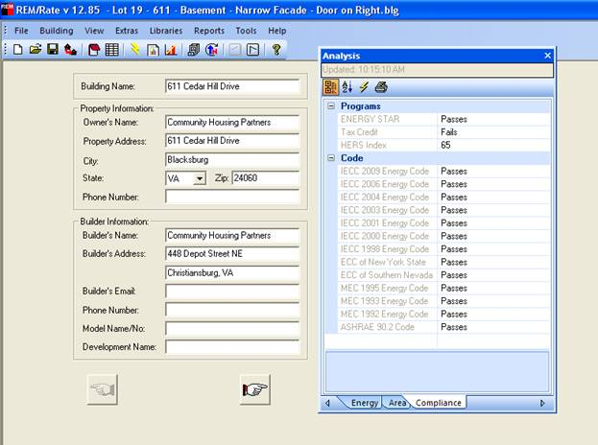

Slide 32
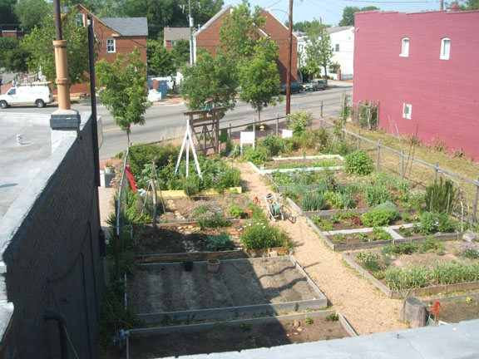

Slide 33
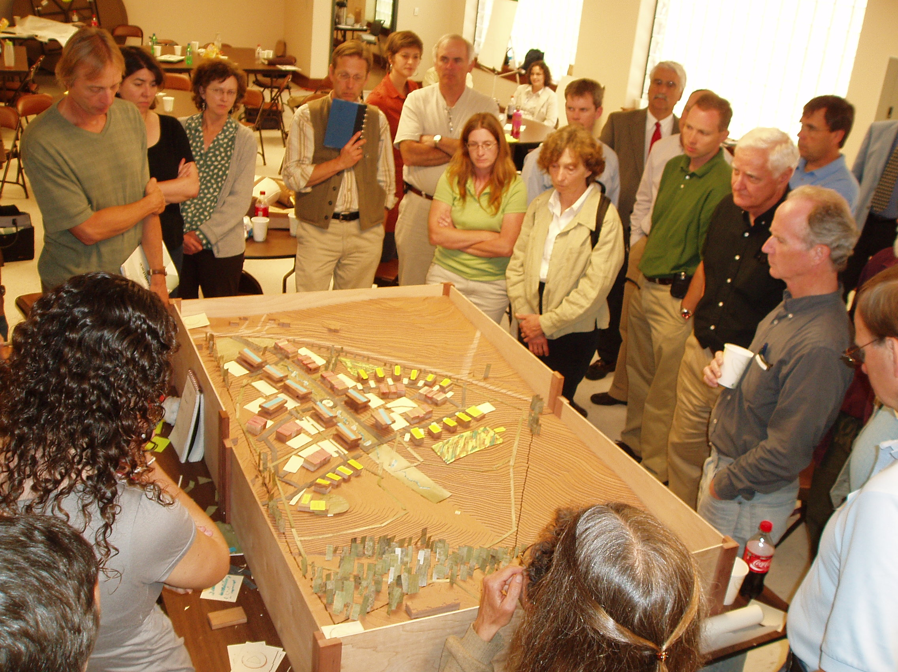

Slide 34
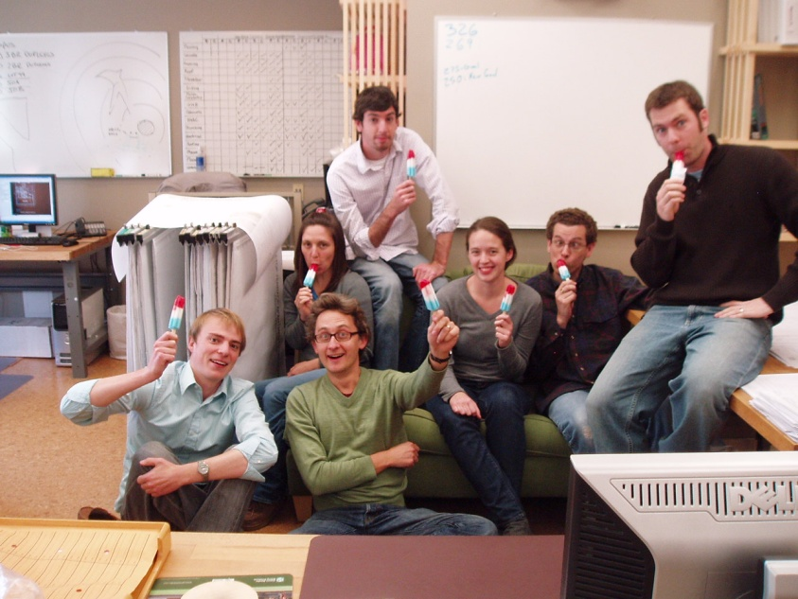

Slide 35
Questions …
Community Design Studio, LLC
communitydesignstudio.org
Community Housing Partners
communityhousingpartners.org
Kyle Rogers
VISTA extraordinaire
krogers@chpc2.org
James Ruhland
Project Manager
jruhland3@chpc2.org

